Slide 1

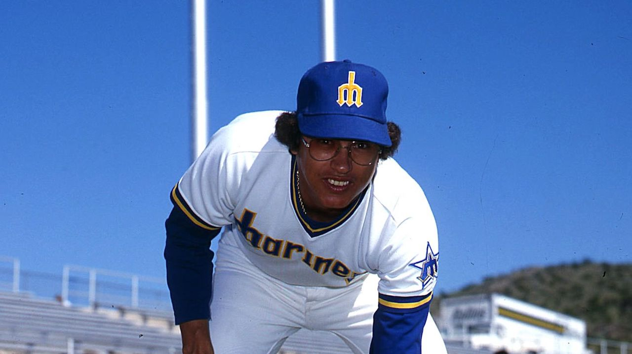
Mendoza Line
Columbia Data Analytics Bootcamp
Project 3 / 12/5/2019
Mike Boccio, Diego Robayo, Viktoriya Smith

Slide 2


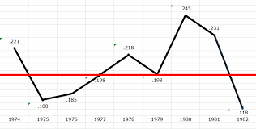
Say what?..
The Mendoza Line is an expression in baseball deriving from the name of shortstop Mario Mendoza, whose poor batting average is taken to define the threshold of incompetent hitting. The cutoff point is most often said to be .200^{[1]} (although Mendoza's career average was .215) and, when a position player's batting average falls below that level, the player is said to be "below the Mendoza Line". This is often thought of as the offensive threshold below which a player's presence on a Major League Baseball team cannot be justified, regardless of his defensive abilities. The term is used in other contexts when one is so incompetent in one key skill that other skills cannot compensate for that deficiency. (Wikipedia)
The Mendoza Line

Slide 3
What we did
Utilized MLB statistical data sets for years ----
Set up PostgreSQL servers
Created FLASK apps to pull the data
Conducted our analysis on the Mendoza Line and other relative factors
Deployed our app on Heroku
Learned valuable insights ☺

Slide 4
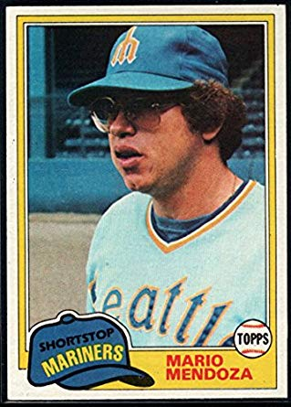
Live Demo
https://columbia-themendozaline.herokuapp.com/

Slide 5
Outcome

